Slide 1
Numerical Basics

Slide 2
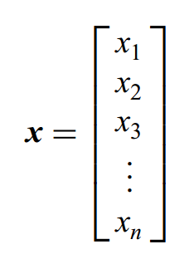
Simple Vector Operations
column vector : An array of elements arranged in a column
For example, an n-dimensional column vector x can be expressed as

Slide 3
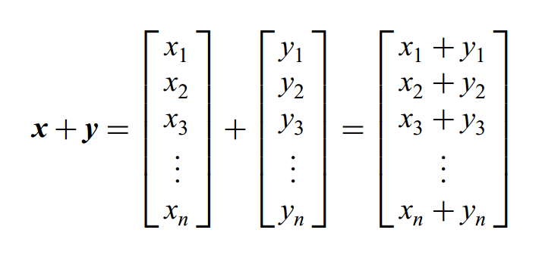
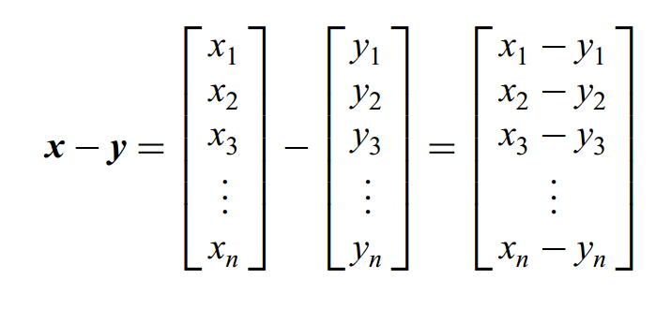
Simple Vector Operations
Two vectors x and y can be added or subtracted by either adding or subtracting

Slide 4
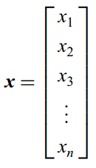
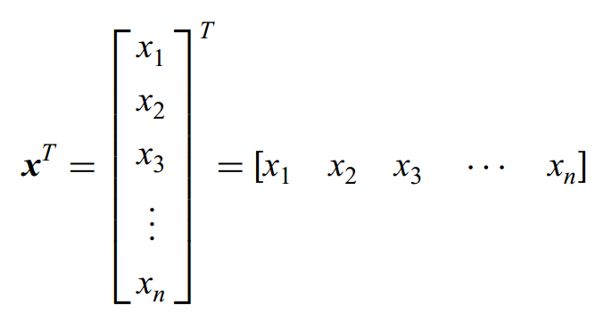
Simple Vector Operations
row vector : The transpose of a column vector is a row vector

Slide 5
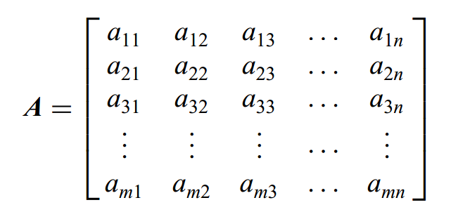
Simple Matrix Operations
Matrix : A matrix is an array of elements consisting of m rows and n columns
For example, the m x n A matrix is given by

Slide 6
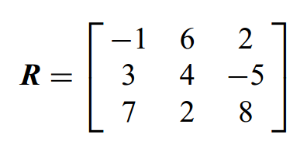
Simple Matrix Operations
square matrix : the number of rows equals the number of columns in a matrix
An example of a 3x3 square matrix is

Slide 7
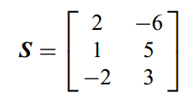
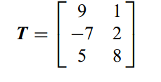
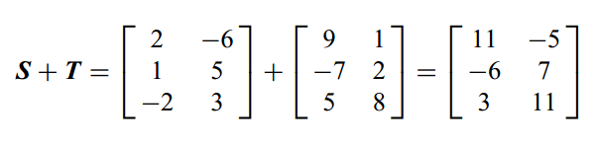
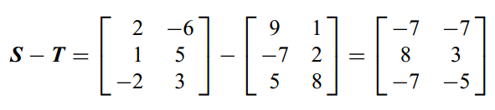
Simple Matrix Operations
matrix addition and subtraction：
Matrix addition and subtraction are only defined when the matrices involved have the same dimensions
Let us consider the 3 x 2 matrices S and T given by

Slide 8
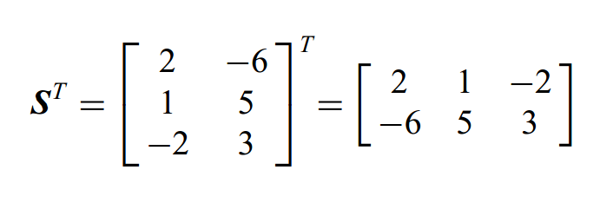
Simple Matrix Operations
When taking the transpose of a matrix, we simply interchange the rows and columns of the matrix

Slide 9

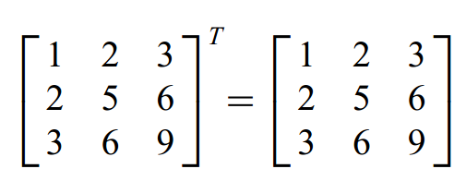
Simple Matrix Operations
A square matrix A is said to be symmetric if the matrix equals its transpose
In other words, the matrix is symmetric

Slide 10
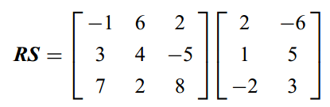
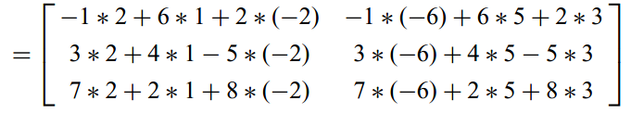
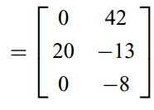
Simple Matrix Operations
we defined a general matrix A with m rows and n columns, The matrix A can only multiply a matrix B if the matrix B has n rows and q columns
For example, we can multiply the matrices already defined R (3 x 3 matrix) with S (3 x2 matrix) and get
The preceding example also illustrates that when a 3 x 3 matrix multiplies a 3 x 2 matrix, we get a 3x 2 matrix.

Slide 11
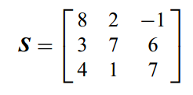
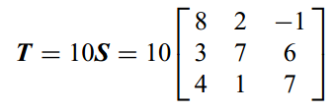
Simple Matrix Operations
We can also multiply a matrix by a scalar. In that case we simply multiply each element of the matrix by the scalar.
For example, if the matrix S is given by
we want to multiply it by the constant or scalar 10 to get the new matrix T

Slide 12
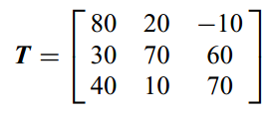
Simple Matrix Operations
After element-by-element multiplication, we obtain

Slide 13

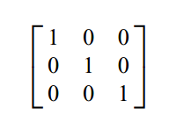
Simple Matrix Operations
The identity matrix is simply a square matrix whose diagonal elements are unity and off diagonal elements are zero.
For example, the 2 x 2 identity matrix is
whereas the 3 x3 identity matrix is given by

Slide 14




Simple Matrix Operations
The inverse of a square matrix A is denoted $A^{−1}$. When a matrix is multiplied by its inverse, we get the identity matrix. In other words
If A is a 2 x 2 matrix denoted by
the inverse of A can be shown to be

Slide 15
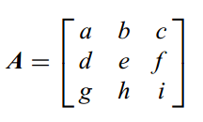
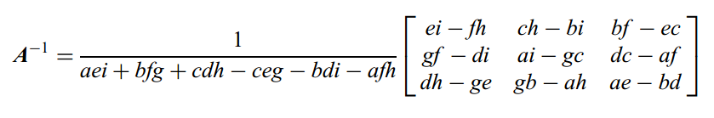
Simple Matrix Operations
If ad = bc , the matrix does not have an inverse.
If A is a 3 x3 matrix given by
the inverse of this matrix is given by

Slide 16


Euler integration
In mathematics and computational science, the Euler method is a numerical procedure for solving ordinary differential equations (ODEs) with a given initial value. It is the most basic explicit method for numerical integration of ordinary differential equations and is the simplest Runge–Kutta method.
Consider a first-order differential equation of the form
We know from calculus that the definition of a derivative of a function can be approximated by

Slide 17

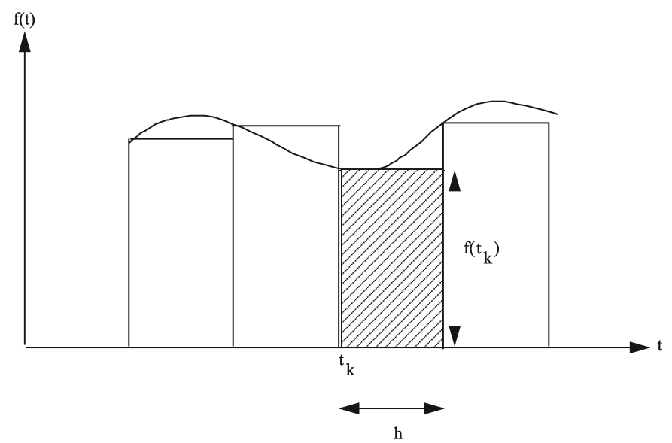
Euler integration
Rearranging terms yields
We learned in calculus that integrating a function is equivalent to finding the area under the function when it is plotted. Euler integration is the simplest approximation available for computing the area under the curve represented by f(x , t).

Slide 18


The second-order Runge–Kutta
However, sometimes Euler integration does not work at all, no matter how small the integration step size. For this reason we will now consider the more accurate second-order Runge–Kutta numerical integration technique.
Given a first-order differential equation of the form
With the second-order Runge–Kutta numerical technique the value of x at the next integration interval h is given by

Slide 19
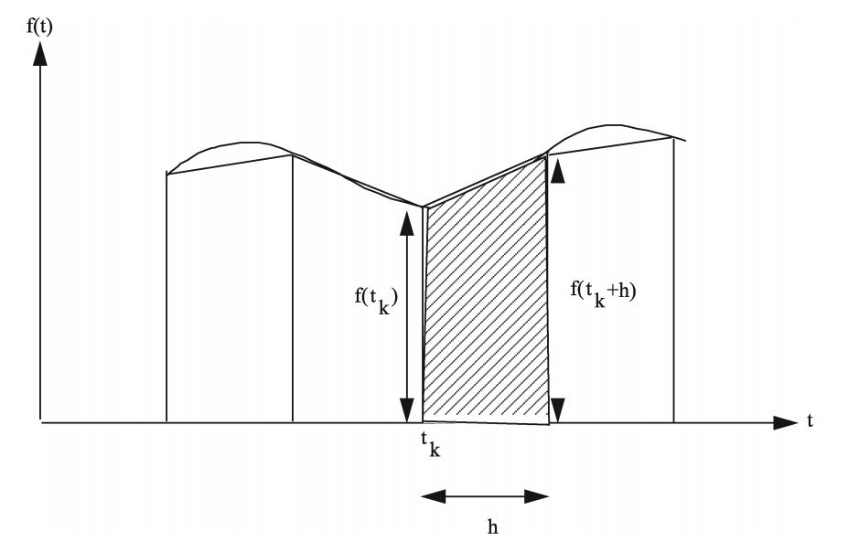
The second-order Runge–Kutta
We can see that the area under the curve is better approximated by a trapezoid than by a rectangle. Therefore, the second-order Runge–Kutta method will be more accurate than Euler integration for a given integration step size.

